Slide 1
From FACT to POD
a practical journey
EAOF conference - drawing on our dialogue
Marion de Boer, POD
4 mei 2018

Slide 2
Little intro POD-way
Chantal Goudsmits
Marion de Boer
25-4-2018
*

Slide 3
25-4-2018
*

Slide 4
25-4-2018
*

Slide 5
25-4-2018
*

Slide 6
25-4-2018
*

Slide 7
filmpjes
https://www.youtube.com/watch?v=YDePi6Wvc2w&sns=em (sadness)
Youtube: open dialogue
https://www.youtube.com/watch?v=aBjIvnRFja4
https://www.youtube.com/watch?v=4EAegtEWsi4&list=PLE3zLa5n17QeBjgRJpCciyZqbQDNhNIxb&sns=em (mark hopfenbeck)

Slide 8
Origins of open dialogue
Initiated in Finnish Western Lapland since early 1980’s
Need-Adapted approach – Yrjö Alanen
Integrating systemic family therapy and psychodynamic psychotherapy
Treatment meeting 1984

Slide 9
Dialogical practice is effective
Open Dialogues in Tornio – 5 years follow-up 1992- 1997 (Seikkula et al., 2006):
- 35 % used antipsychotic drugs
- 81 % no remaining psychotic symptoms
- 81% returned to full employment

Slide 10
Outcomes stable 2003 – 2005 (Aaltonen et al., 2011 and Seikkula et al, 2011):
- DUP declined to three weeks
- about 1/3 used antipsychotic drugs
- 84 % returned to full employment
- Few new schizophrenia patients: Annual incidence declined from 33 (1985) to 2-3 /100 000 (2005)

Slide 11
Core principles…
The provision of immediate help – first meeting arranged within 24 hours of contact made.
Flexibility & Mobility: “Using the therapeutic methods that best suit the case”
Being in different place, needed time.

Slide 12
Responsibility: “the same team or person responsible”
A social network perspective – patients, their families, carers & other members of the social network are always invited to the meetings

Slide 13
Psychological continuity: The same team is responsible for treatment – engaging with the same social network – for the entirety of the treatment process
Dialogism; promoting dialogue is primary and, indeed, the focus of treatment. “the dialogical conversation is seen as a forum where families and patients have the opportunity to increase their sense of agency in their own lives.”
Tolerance of uncertainty: “An active attitude among the therapists to live together with the network, aiming at a joint process… so as to avoid premature conclusions or decisions”

Slide 14
Peer supported open dialogue
In 2017 7 members of FACT, GGzE receive training in UK, londen.
Together with 4 other organizations from the Netherlands, 31 people
Started in Finland, in England training “POD”
90 people in England
four weeks
personal and theoretical

Slide 15
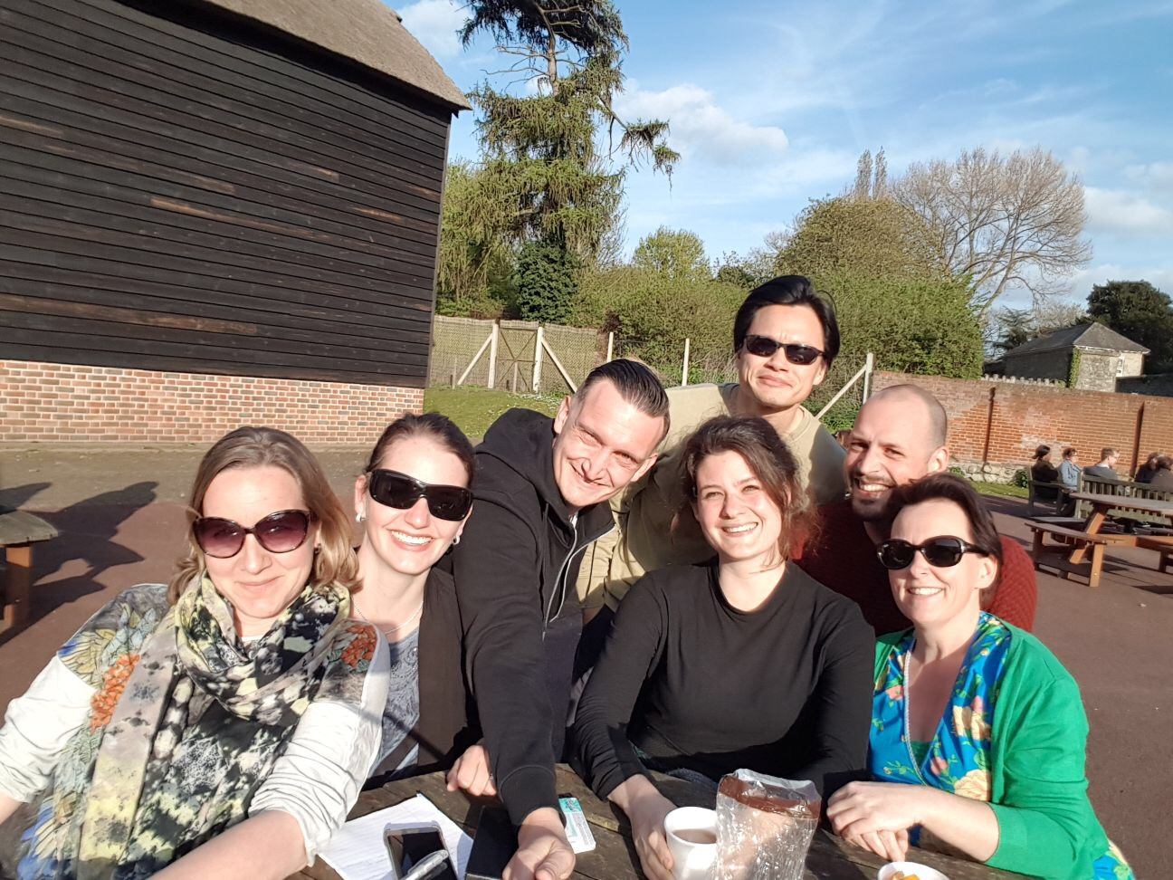

Slide 16
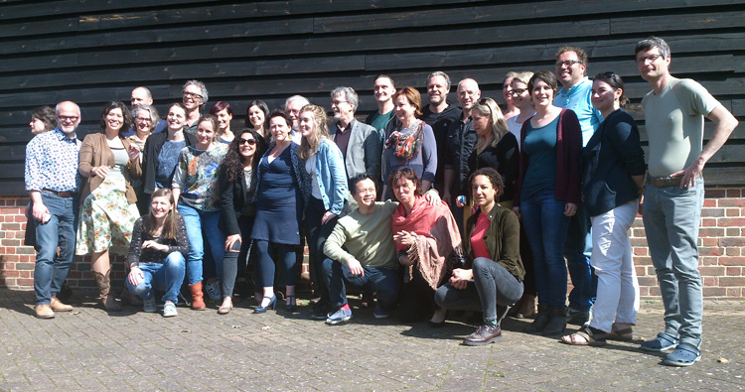

Slide 17
The “P” in POD
A peer worker in every team; their experience is itself recognised as a form of expertise in the team.
A “we are all peers” mentality in the team, combatting the “them and us” mentality.
Cultivating local initiatives, especially when social networks are limited or lacking.
25-4-2018
*

Slide 18
Mindfullness
Mark Hopfenbeck (coördinator POD training):
“Psychiatrists are not selected in their training on their social skills, but you can learn that. Unconditional warmth is difficult to learn in a course, this requires reflection. For whom this is naturally difficult, mindfulness helps. "
- There is evidence that mindfullness improves the therapeutic relationship. It is about connecting and feeling compassion.
F

Slide 19
Mindfullnes practice
25-4-2018
*

Slide 20
Exercise listening and reflecting
Groups 4 or 5
One subject, one/two interviewers, rest reflecting team
Interview about a time they were in a situation where they didn’t feel listened to and they were unable to get the other prson to listen to them.
- Handing out notes for participants.
25-4-2018
*

Slide 21
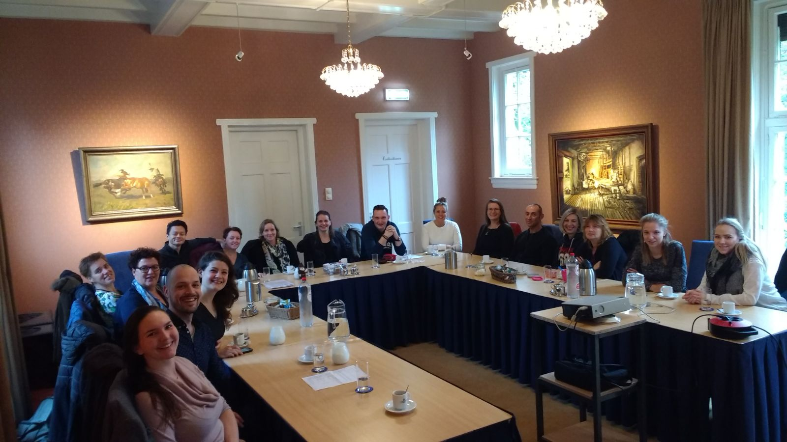
Start first POD-team Netherlands
1 novembre 2017

Slide 22
Collecting questions about our situation.
Listen to people
Then make a conversation with two of us.
Give space to others to reflect on that.
Goal: to give an idea on how we do things in Eindhoven and have a dialogue about that.
25-4-2018
*

Slide 23
25-4-2018
*

Slide 24
25-4-2018
*

Slide 25
Ending with fishbowl
What did evoke with you?
What do you want to share?
25-4-2018
*

